Slide 1
Wheels Presentation:
Project Report
By: Ayoyinka Sofuwa

Slide 2
Business Overview
Total Revenue
Total Orders
Total Customers
Avg Rating
83.2 M
1000
994
3.1
Last Qtr Revenue
Last Qtr Orders
Avg Days to Ship
% Good Feedback
1.53 M
199
98
64%

Slide 3
Customer Metrics

Slide 4
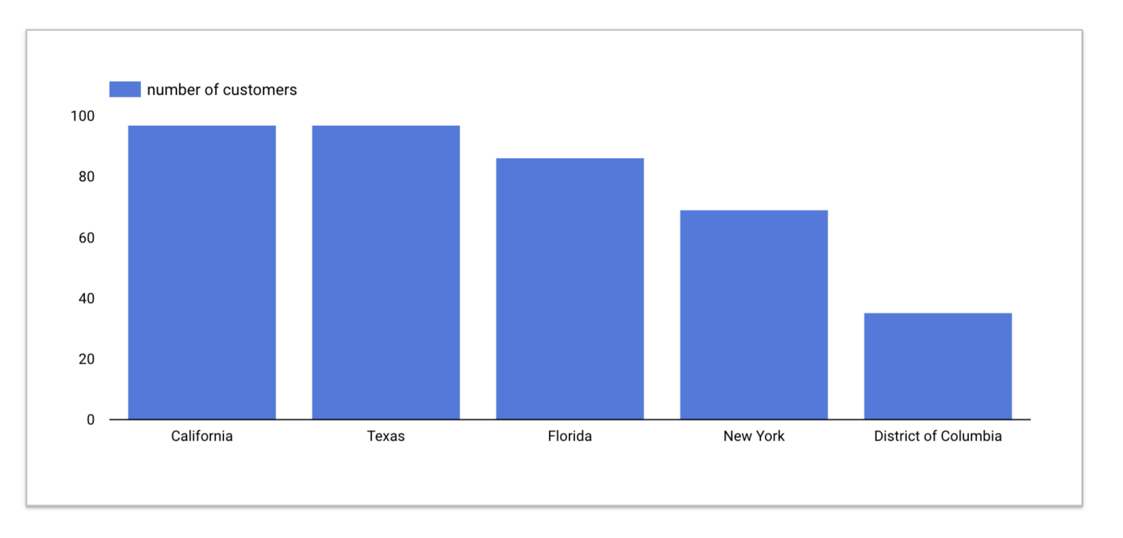
Distribution of customers across states.
Observations and findings:
⧫
California, Texas, Florida, New York, and the District of Columbia consistently rank among the top 5 states with the highest number of customers.

Slide 5
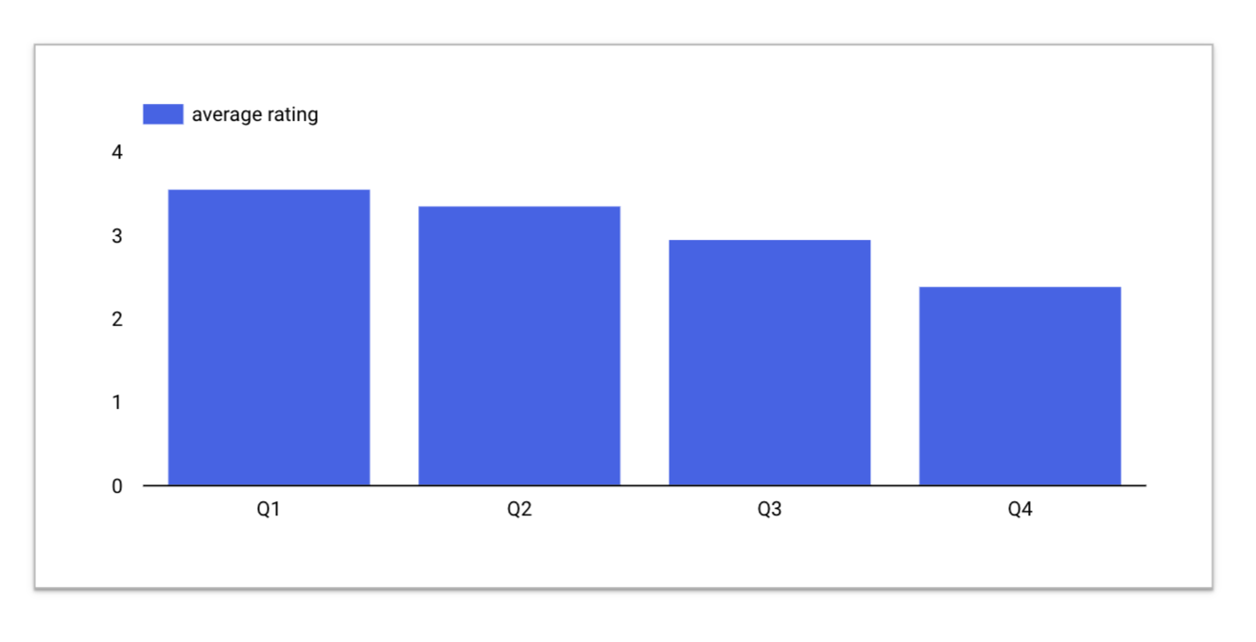
Average Customer rating by Quarter
Observations and findings:
⧫
The ratings are generally better as the year begins and significantly drops as towards the end of the year. This may be indicative of longer wait times, and poor service as the year progressed.

Slide 6
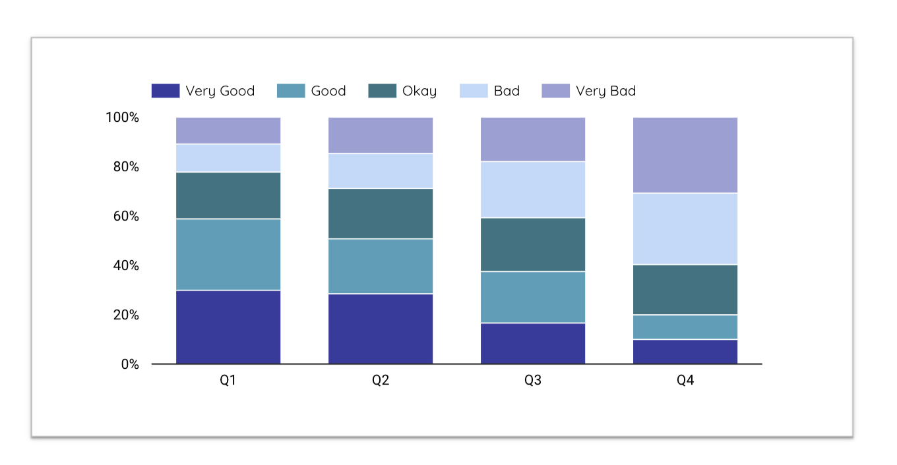
Trend of Customer Satisfaction
Observations and findings:
⧫
The quality of the service offered to customers was perceived to be less valuable at the end of the year than it was at the beginning of the year so there was a decline in ratings over the course of the year.

Slide 7
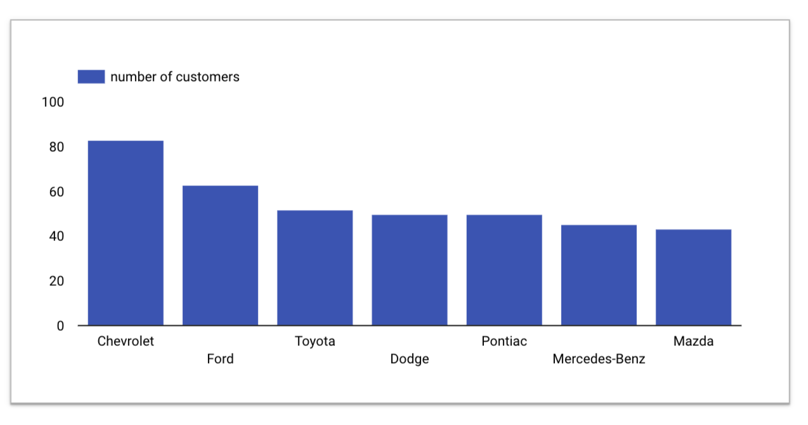
Top Vehicle makers preferred by customers
Observations and findings:
⧫
Chevrolet and Ford are shown to be the most preferred vehicle makers by the customers

Slide 8
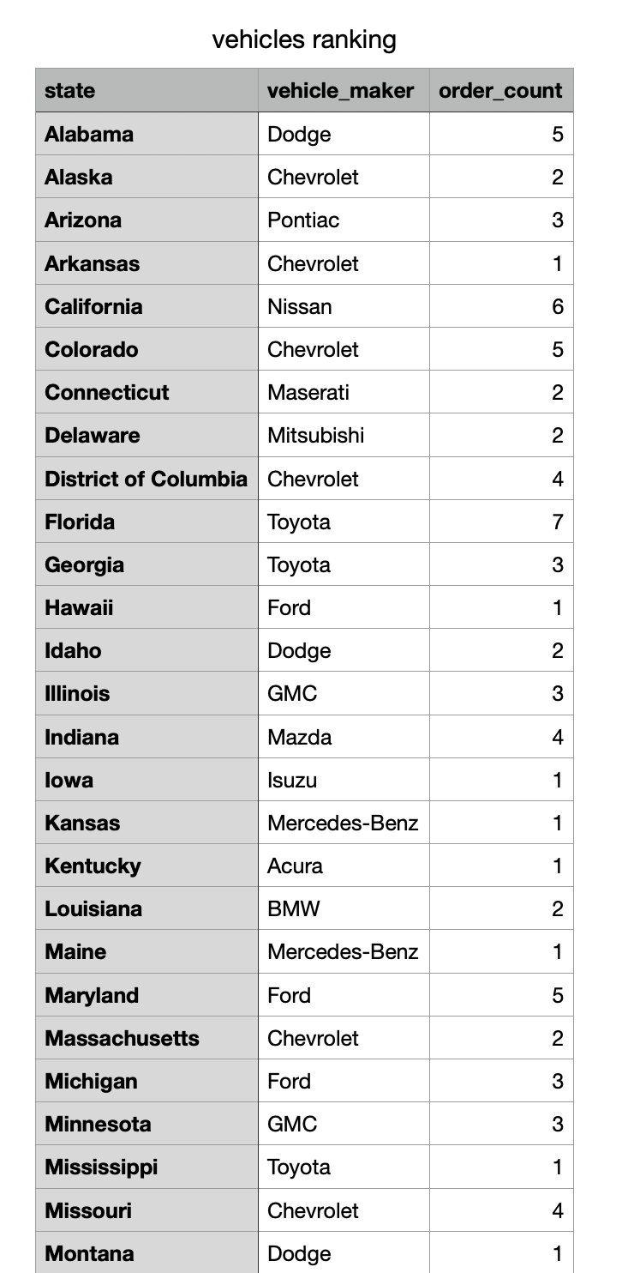
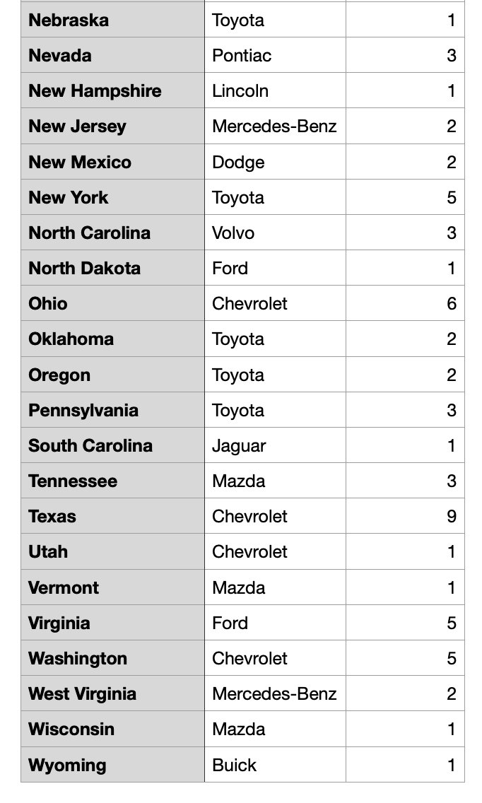
Most preferred vehicle make in each state
Observations and findings:
⧫ Here we can see the most preferred vehicle make in each state. For example, in Texas, Chevrolets are more popular.

Slide 9
Revenue Metrics

Slide 10
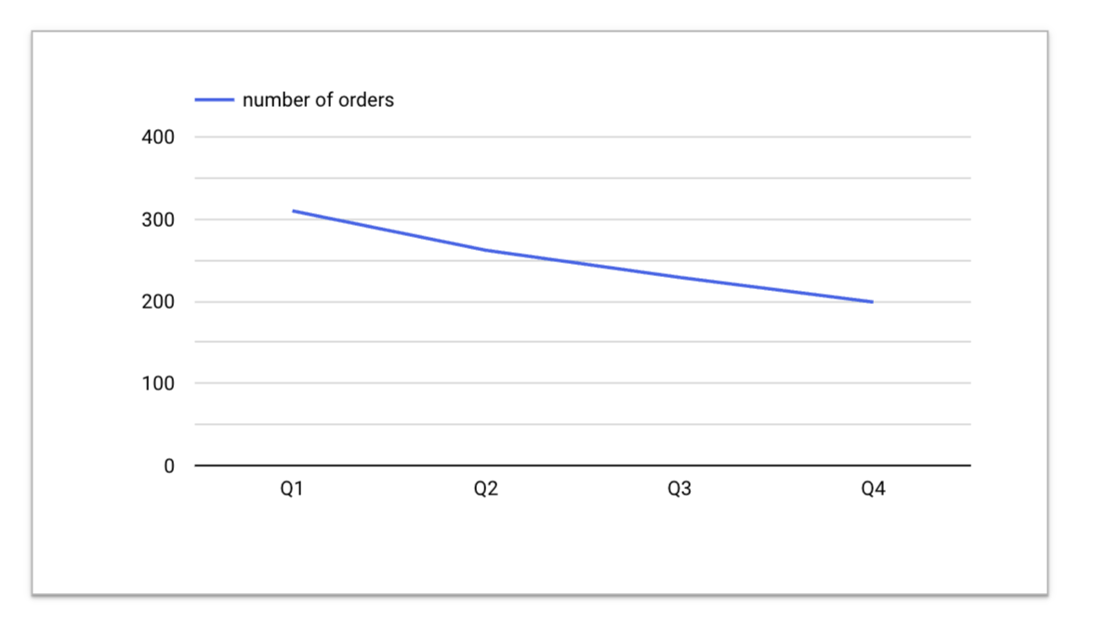
Trend of purchases by Quarter
Observations and findings:
⧫
From the chart, we observe a steep decline in purchases between Q1 and Q2, and a steady decline from Q2 down to Q4. And this confirms that the number of orders dropped over the course of the year.

Slide 11
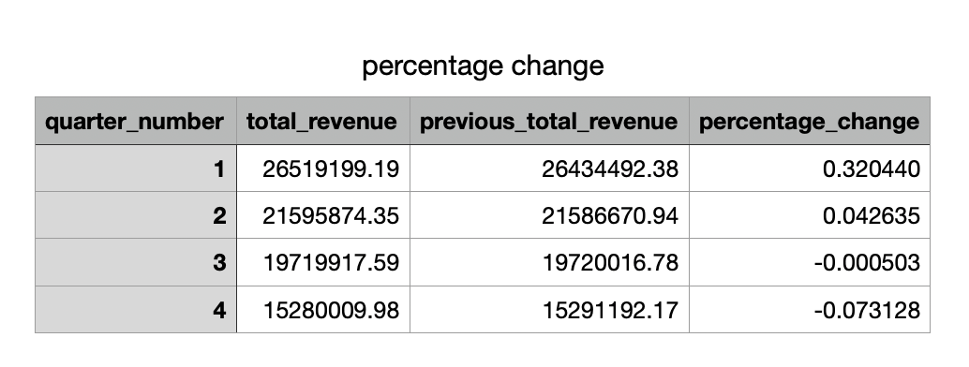
Quarter on Quarter % change in Revenue
Observations and findings:
⧫ This table shows a drop in percentage change per quarter over the course of the year

Slide 12
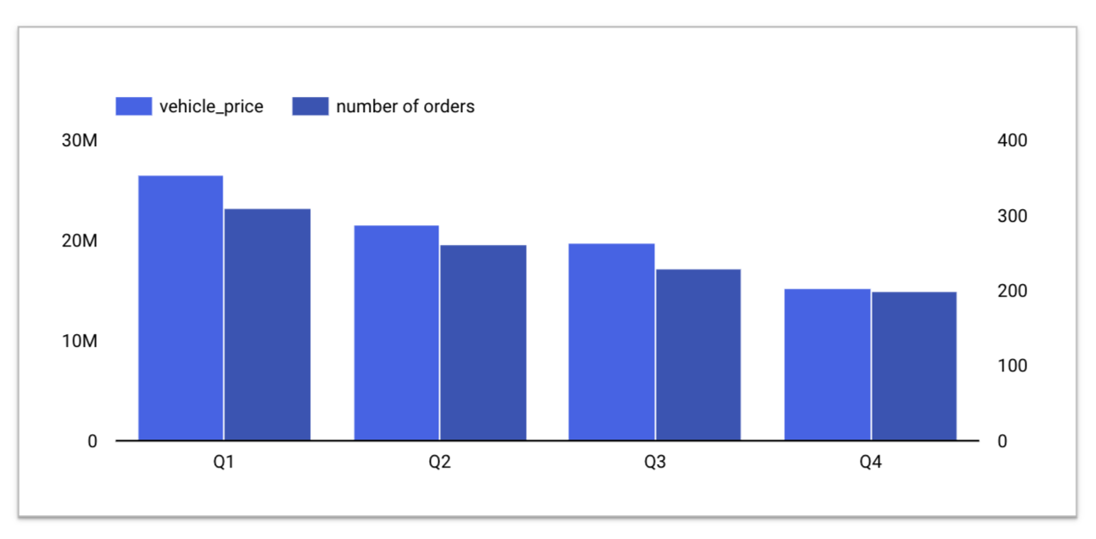
Trend of Revenue and Orders by Quarter
Observations and findings:
⧫
Due to the direct relationship between number of orders and revenue, we can infer that a decline in orders causes decline in revenue which can happen as a result of a number of factors.

Slide 13
Shipping Metrics

Slide 14
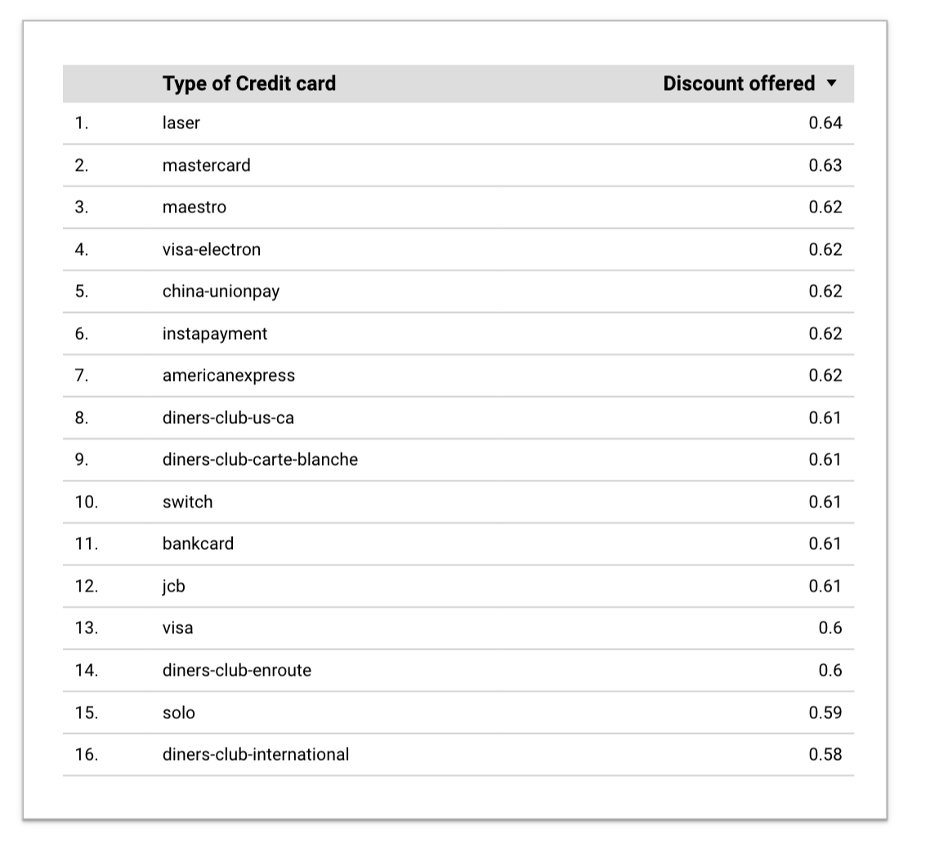
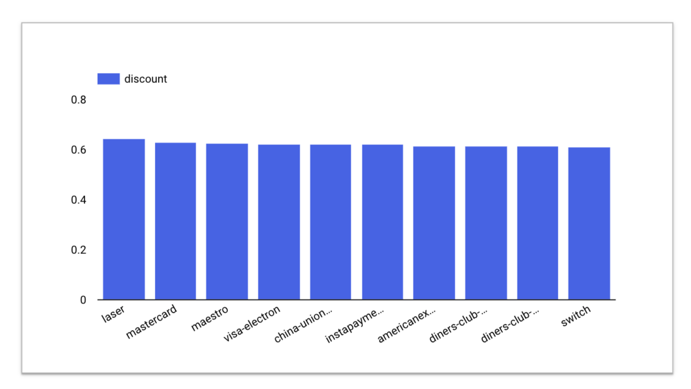
Average discount offered by Credit Card type
Observations and findings:
⧫
The average discount offered on each credit card ranges between 0.58 and 0.64

Slide 15
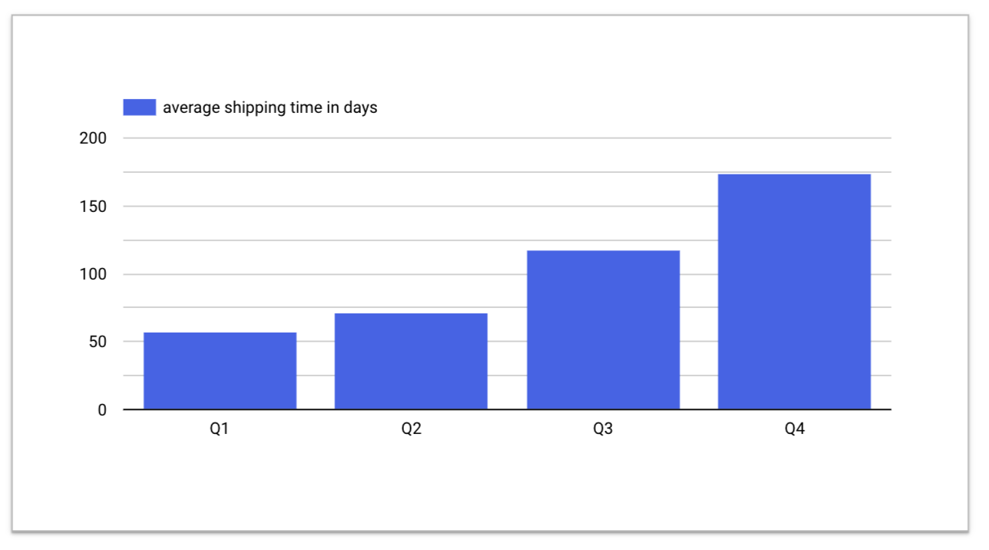
Time taken to ship orders by Quarter
Observations and findings:
⧫
Shipping time generally increased over the course of the year.

Slide 16
Insights and Recommendations
⧫
Over the course of the year, ratings, revenue and orders declined which could have been due to a myriad of issues around quality control, logistics and supply chain management, technological problems and external factors.
Recommendations
More investigation should be made to determine the cause of the decline in customer satisfaction, hence the decline in orders.
For example:
Faster shipments might increase customer ratings, orders and then revenue.

